Slide 1
CSCI2100E Stacks

Slide 2
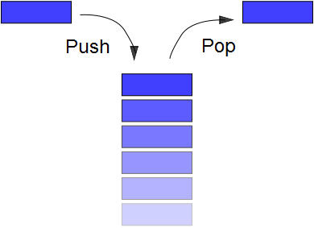
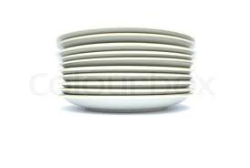
Stack
Last-In-First-Out (LIFO): The last element being pushed onto a stack is the first element that pops out.
The efficiency comes with restricted accesses.

Slide 3
Stack ADT
Top ->
a_{n-1}
…..
a₁
A stack is an ordered list in which insertions and deletions are made at one end called “top”.
Given a stack S = (a₀, a₁, ... , a_{n-1}) where a₀ is the bottom element, a_{i} is on top of a_{i-1}.
Operations:
stack CreateS(int): create an empty stack with max elements.
Boolean IsEmpty(stack): if a stack is empty return TRUE. Otherwise, return FALSE.
Boolean IsFull(stack): if a stack is full return TRUE. Otherwise, return FALSE.
Push(stack, element): add an element onto the top of a stack.
element Pop(stack): return and delete the topmost element on a stack.
element Top(stack): return the topmost element on a stack.
a₀

Slide 4
Stack Implementation (integers)
typedef enum {FALSE = 0, TRUE = 1} Boolean;
typedef struct {
int size;
int top;
int *stacklist;
} stack;
stack *createS(int size){
stack *s;
s = (stack*)malloc(sizeof(stack));
s->size = size;
s->stacklist = (int*)malloc(size * sizeof(int));
s->top = -1;
return s;
}
E.g. mystack = createS(6);
mystack
size
6
stacklist[0]
top
-1
stacklist[1]
stacklist
stacklist

Slide 5
Stack Implementation (integers)
Boolean IsFull(stack *s){
if (s->top == s->size - 1)
return TRUE;
else return FALSE;
}
Boolean IsEmpty(stack *s){
if (s->top == -1)
return TRUE;
else return FALSE;
}
mystack
6
stacklist[0]
10
size
stacklist[1]
8
top
2
15
top
stacklist
stacklist

Slide 6
Stack Implementation (integers)
void push(stack *s, int e){
if (! IsFull(s)) {
s->top++;
s->stacklist[s->top] = e;
}
}
int pop(stack *s){
int i;
if (! IsEmpty(s)) {
i = s->stacklist[s->top];
s->top--;
return i;
} else { printf("error\n"); return -1; }
}
int top(stack *s){ return s->stacklist[s->top];}
mystack
6
stacklist[0]
10
size
stacklist[1]
8
top
2
15
top
stacklist
stacklist

Slide 7
Dynamically Linked Stack (Another implementation)
typedef struct listNode { int data; listPointer link;
};
stack *createS(){
stack *s;
s = (stack*)malloc(sizeof(stack));
s->element = NULL;
return s;
}
Boolean IsEmptyS(stack *s){return IsEmptyL(s->element);}
typedef struct {
listNode *element;
} stack;
listNode* element
12
20
40
top

Slide 8
Dynamically Linked Stack (Another implementation)
void push(stack *s, int e){
s->element = prepend(s->element, e);
}
int pop(stack *s){
int i;
listPointer t;
if (!IsEmptyS(s)) {
t = nth(s->element, 0);
i = t->data;
s->element = delete(s->element, NULL); /* delete the first */
return i;
} else printf("Error\n");
}

Slide 9
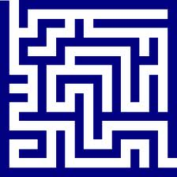
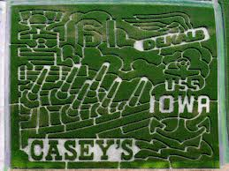
Maze
How to solve it?
Need to try all the possible ways.
Need to remember the ways that have been tried.

Slide 10
The MAZE Problem
int maze[15][11];
int entryX = 0, entryY = 0, exitX = 14, exitY = 10;
entry-> 0 1 1 0 0 1 0 0 0 0 0 1 1 1 1
0 0 0 0 1 1 0 1 1 1 0 0 1 1 1
0 1 1 0 0 0 0 0 1 1 1 0 0 0 1
1 1 0 0 1 1 1 0 1 1 0 1 1 0 0 N
1 1 0 1 1 0 1 0 0 1 1 1 1 1 1 |
0 0 0 1 1 0 1 1 0 1 1 1 1 1 1 W -+- E
0 1 1 1 1 0 1 1 1 1 1 1 1 1 1 |
0 0 0 1 0 0 0 0 1 1 1 1 1 0 1 S
1 1 0 0 0 1 1 0 1 1 0 0 0 0 0
0 0 0 1 1 1 1 0 0 0 0 1 1 1 0
0 1 0 0 1 1 1 1 1 0 1 1 1 1 0 -> exit

Slide 11

A Data Structure
Need to define a data structure for remembering a corner in the maze
The location: x and y.
The direction we have tried in a predefined order: E → S → W → N .
Let the data structure be typedef struct { int x, y; char dir; } position; In short, we use <x, y, dir> to represent the structure.
This is the data structure to be pushed/popped in a stack.

Slide 12
Maze: The Main Ideas
Remember the path from the entrance to the current position (Stack).
Move forward: Push!
To remember where we have visited.
Move backward: Pop!
To get where we were last time.
Remember the positions being tracked on the maze (Mark[][]).

Slide 13
Pseudo Codes: get the maze's entrance.
while (there is still a way to try) {
get the current position and direction we are now;
mark the current to remember we have visited;
while (there is a possible move from the current) {
identify the next position and direction to go;
if (the next position is the exit)
success and report the path;
if (the next position is not wall and we have not visited before){
mark the next position to remember;
remember it is as a step of the path;
let the current (of the next move) be the next;
}}}
printf("No path found\n");

Slide 14
Maze Problem: An example
int maze[4][3];
int entryX = 0, entryY = 0, exitX = 3, exitY = 2;
0 0 0 1
0 1 1 0
0 0 0 0
0 0 0 1
0 1 1 0
0 0 0 0

Slide 15
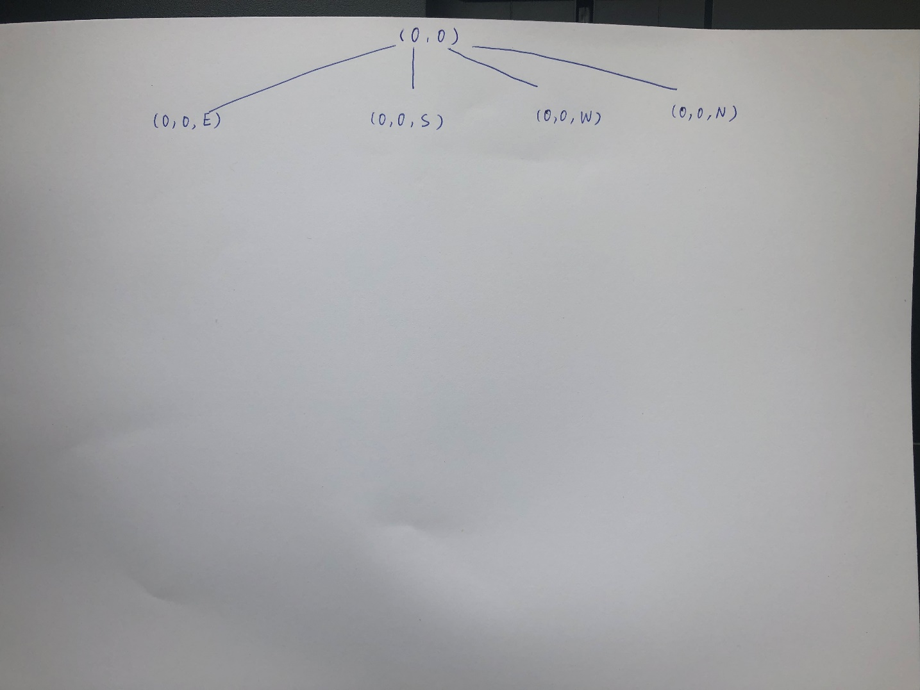
Search Space of Maze Problem
0 0 0 1
0 1 1 0
0 0 0 0
stack

Slide 16
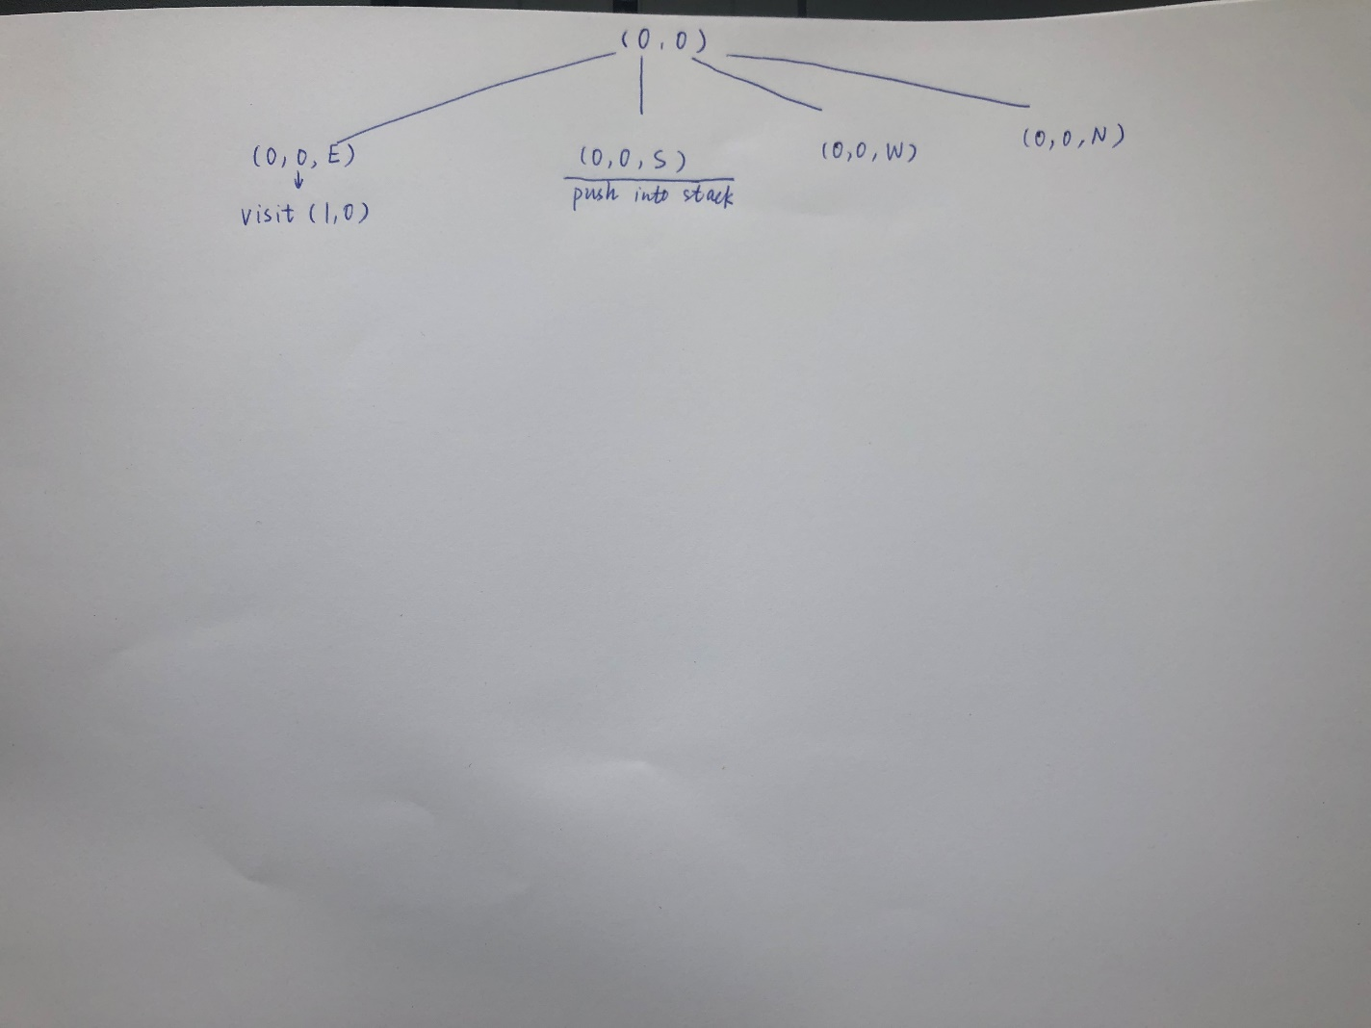
Search Space of Maze Problem
0 0 0 1
0 1 1 0
0 0 0 0
(0,0,S)

Slide 17
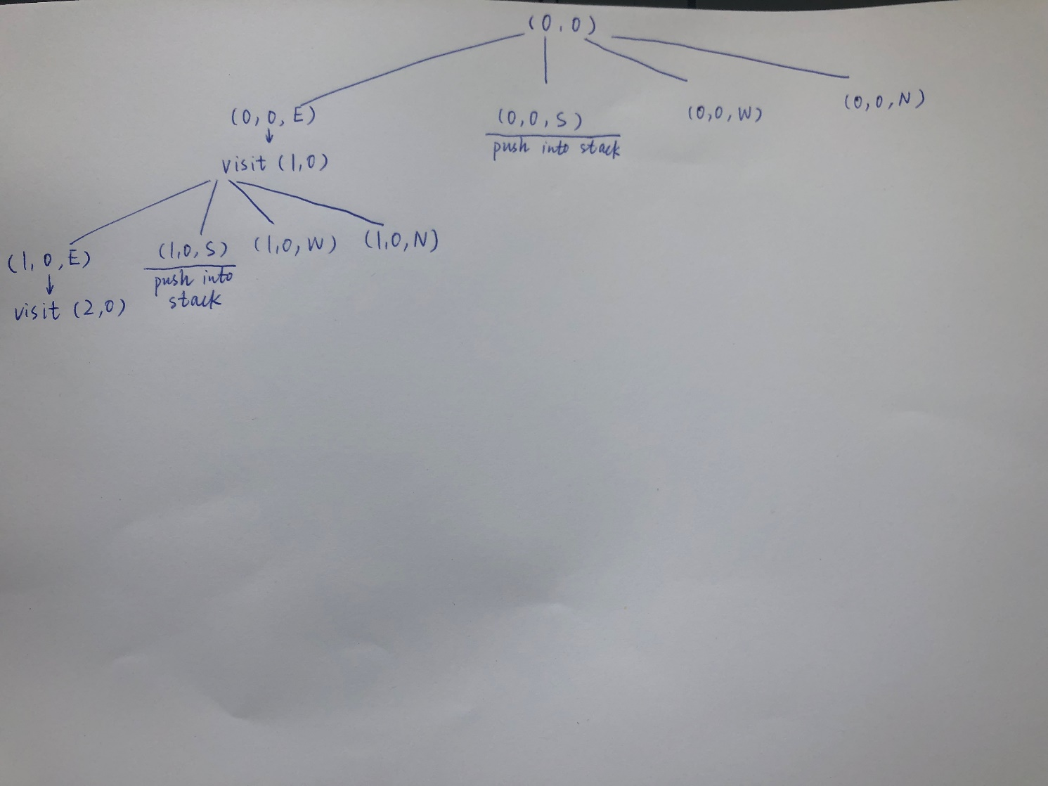
Search Space of Maze Problem
0 0 0 1
0 1 1 0
0 0 0 0
(1,0,S)
(0,0,S)

Slide 18
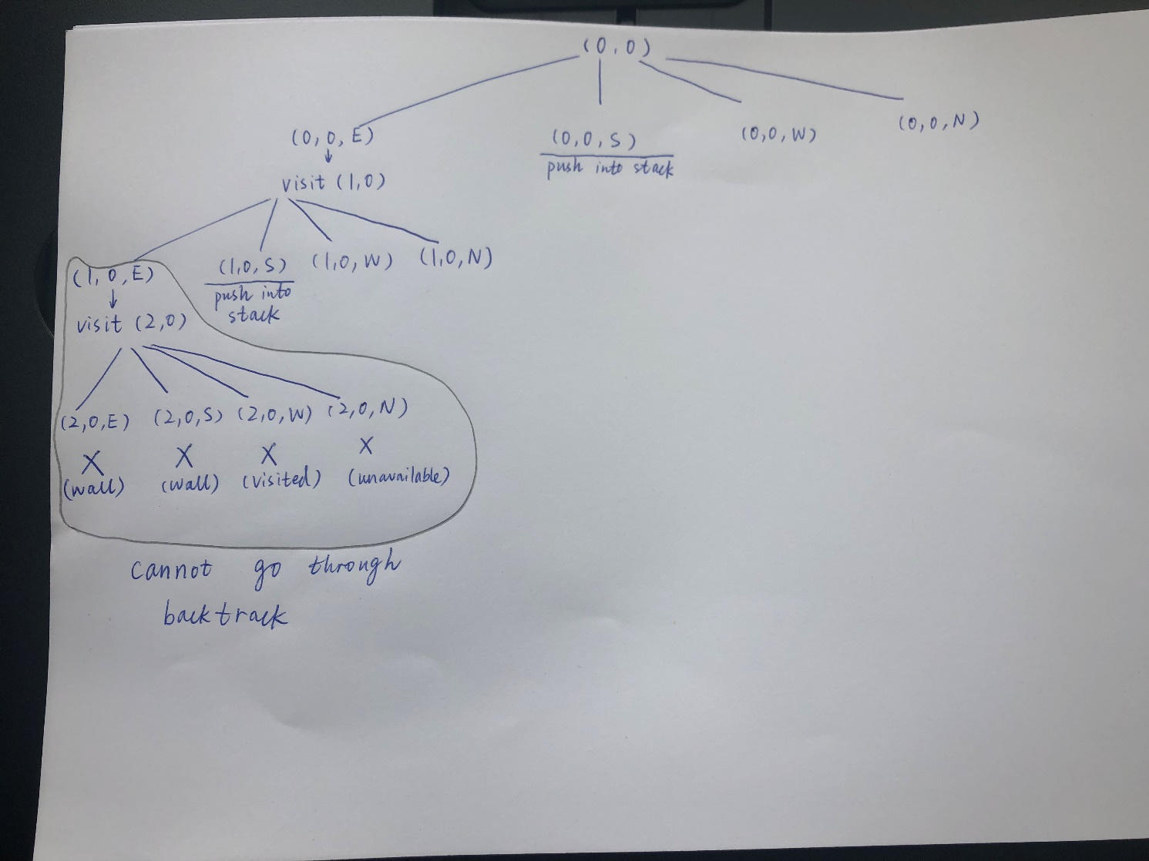

Slide 19
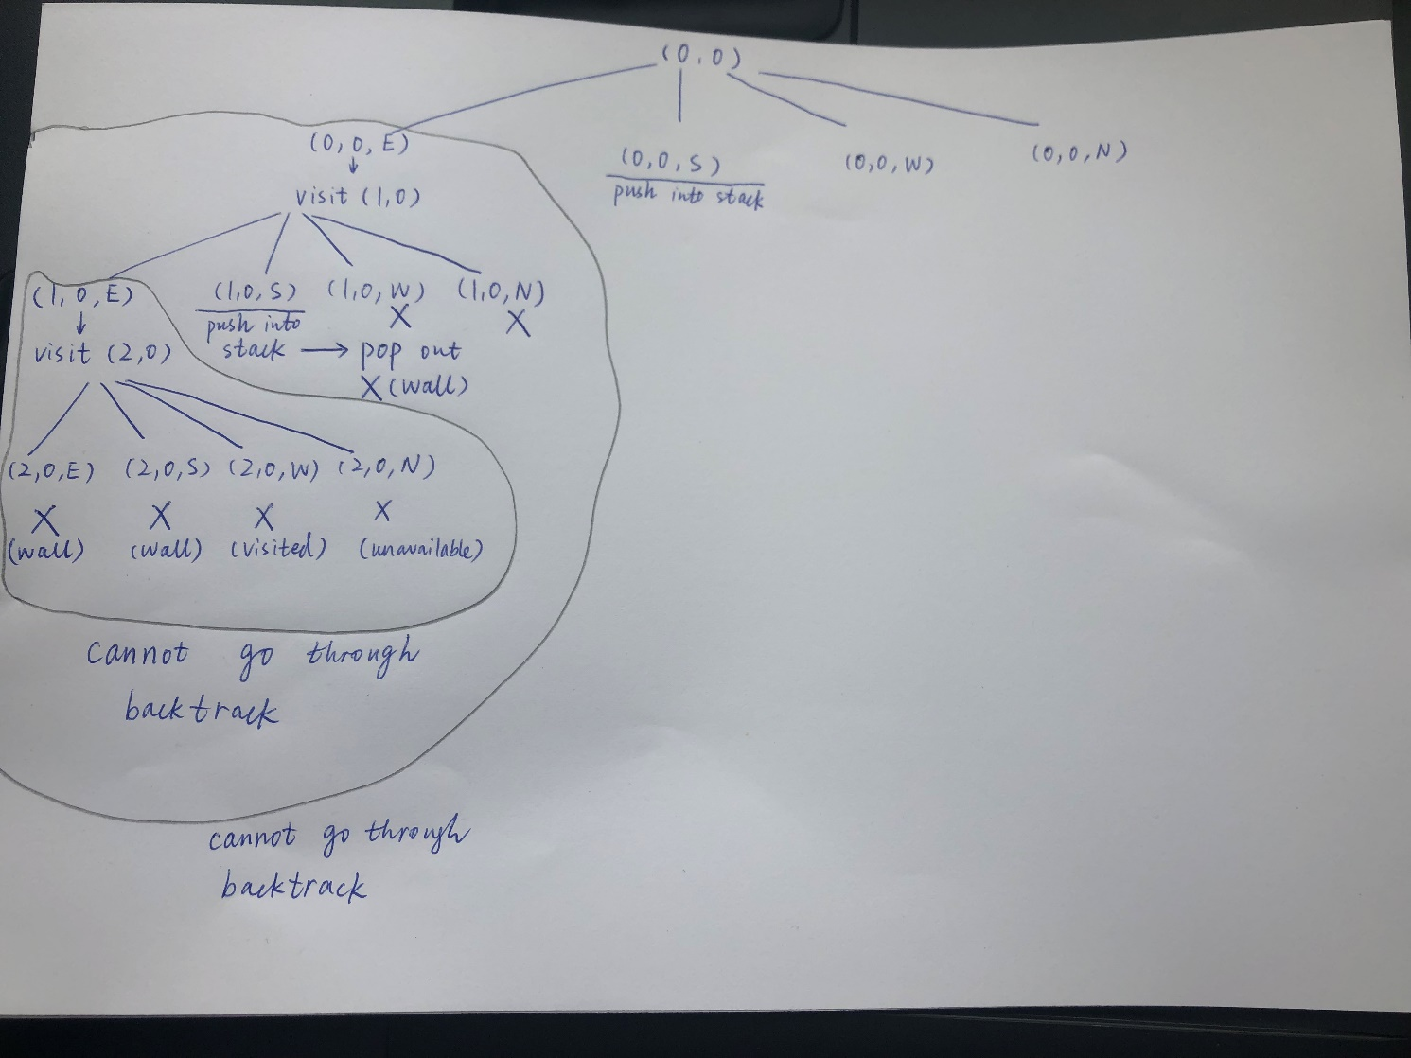
0 0 0 1
0 1 1 0
0 0 0 0
(0,0,S)

Slide 20
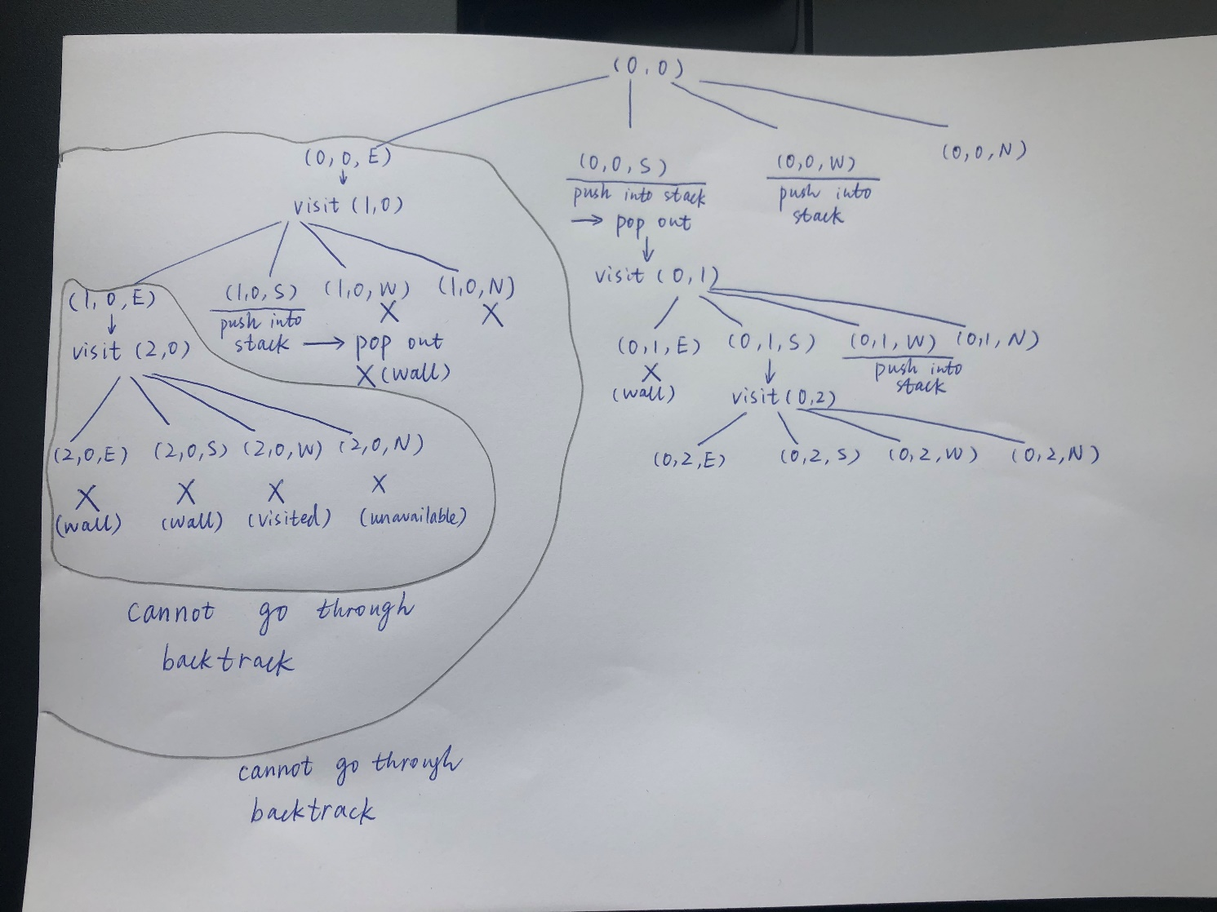
0 0 0 1
0 1 1 0
0 0 0 0
0 0 0 1
0 1 1 0
0 0 0 0
0 0 0 1
0 1 1 0
0 0 0 0
0 0 0 1
0 1 1 0
0 0 0 0
(0,1,W)
(0,0,S)
(0,0,W)
(0,0,W)

Slide 21
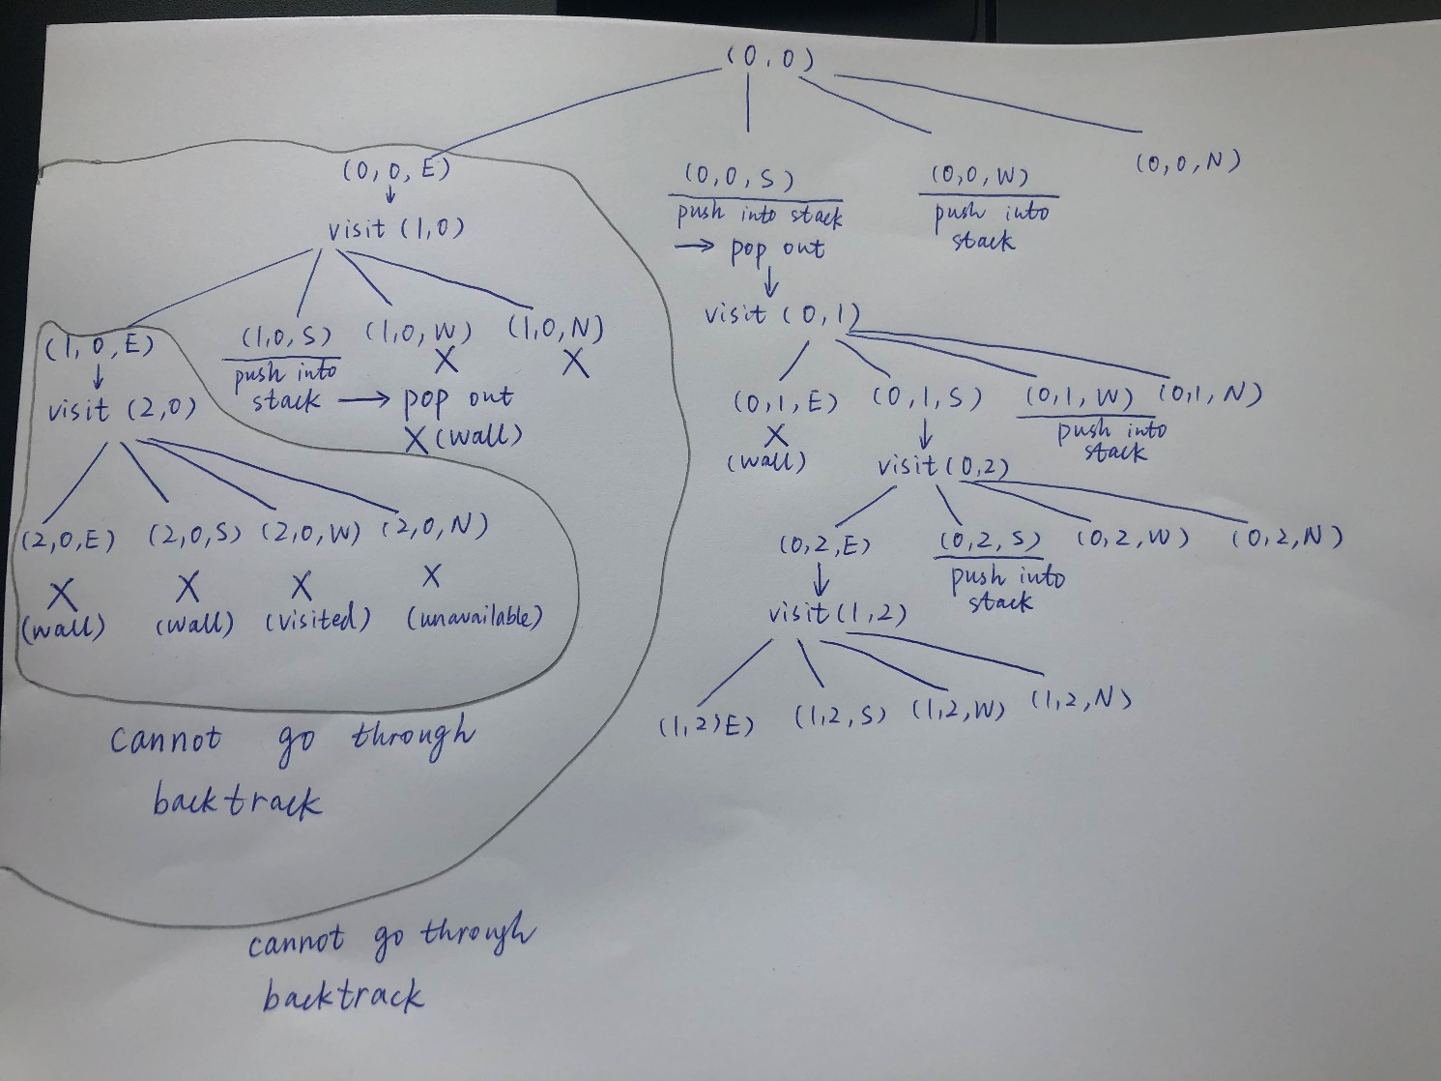
0 0 0 1
0 1 1 0
0 0 0 0
(0,2,S)
(0,1,W)
(0,0,W)

Slide 22
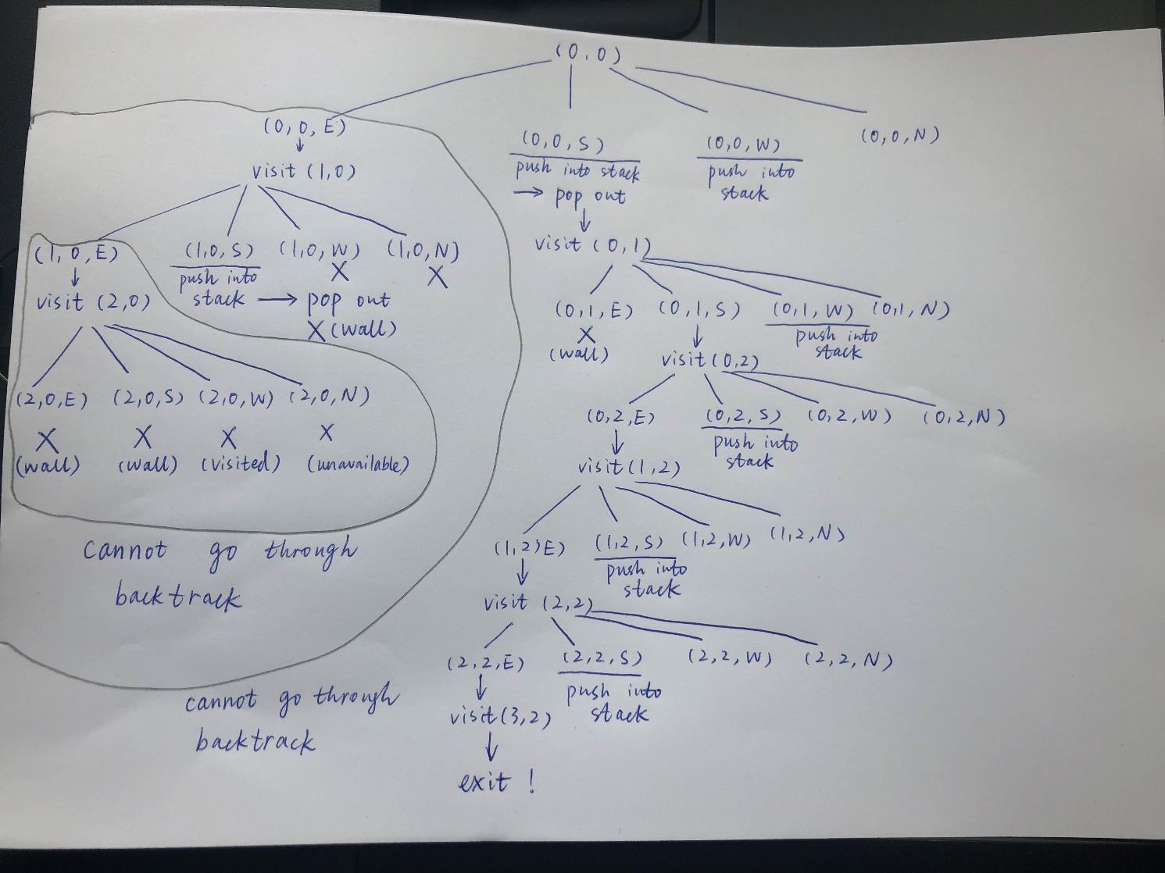
0 0 0 1
0 1 1 0
0 0 0 0
0 0 0 1
0 1 1 0
0 0 0 0
0 0 0 1
0 1 1 0
0 0 0 0
(2,2,S)
(2,2,S)
(1,2,S)
(1,2,S)
(1,2,S)
(0,2,S)
(0,2,S)
(0,2,S)
(0,1,W)
(0,1,W)
(0,1,W)
(0,0,W)
(0,0,W)
(0,0,W)

Slide 23
Maze Problem: Stack Content
int maze[4][3];
int entryX = 0, entryY = 0, exitX = 3, exitY = 2;
0 0 0 1
0 1 1 0
0 0 0 0
0 0 0 1
0 1 1 0
0 0 0 0
0 0 0 1
0 1 1 0
0 0 0 0
0 0 0 1
0 1 1 0
0 0 0 0
stack
(1,0,S)
(0,0,S)
(0,0,S)
(0,0,S)
line-3
line-13
line-13
line-3
Red number means the current position. _ means visited as marked.

Slide 24
Maze Problem: Stack Content
0 0 0 1
0 1 1 0
0 0 0 0
0 0 0 1
0 1 1 0
0 0 0 0
0 0 0 1
0 1 1 0
0 0 0 0
0 0 0 1
0 1 1 0
0 0 0 0
(0,1,W)
(0,0,S)
(0,0,W)
(0,0,W)
line-9
line-3
line-13
line-13

Slide 25
Maze Problem: Stack Content
0 0 0 1
0 1 1 0
0 0 0 0
0 0 0 1
0 1 1 0
0 0 0 0
0 0 0 1
0 1 1 0
0 0 0 0
0 0 0 1
0 1 1 0
0 0 0 0
(2,2,S)
(2,2,S)
(1,2,S)
(1,2,S)
(1,2,S)
(0,2,S)
(0,2,S)
(0,2,S)
(0,2,S)
(0,1,W)
(0,1,W)
(0,1,W)
(0,1,W)
(0,0,W)
(0,0,W)
(0,0,W)
(0,0,W)
line-13
line-13
line-13
line-13

Slide 26
Pseudo Codes: initialize a stack to the maze's entrance.
1 while (stack is not empty) {
<x,y,dir> = pop from the top of stack;
mark[x][y] = 1; /* visited */
while (there is a possible move from <x,y,dir>) {
<next_x, next_y> = coordinates of next move;
dir = next direction of move;
if ((next_x == exitX) && (next_y == exitY))
success and print the steps in the stack;
if (maze[next_x][next_y] == 0 &&
mark[next_x][next_y] == 0){
mark[next_x][next_y] = 1;
push <x,y,dir> to the stack;
x = next_x; y = next_y; dir = East;
}}}
printf("No path found\n");
0 0 0 1
0 1 1 0
0 0 0 0
(0,0,E)
(0,0,S)
Stack
initialization

Slide 27

Calculator
How do we do calculation?
How does a machine do calculation?
Are they doing the things in the same way?
The algorithm?
The data structure to be used?

Slide 28
Expressions: What We Learnt
An example: a / b - c + d * e - a * c
Four basic binary operators: +, -, *, /.
Operands: a, b, c, d, e.
Precedence of operators: The order in which the operators are performed.
(((a / b) - c) + (d * e)) - (a * c)
How do we evaluate operators with the same precedence?
a + b + c = (a + b) + c
The operators such as +, -, * and / are left-associative (from left to right).
Parentheses can be used to override precedence and expressions are always evaluated from the innermost parenthesized expression,
Example: a * (b + c)

Slide 29
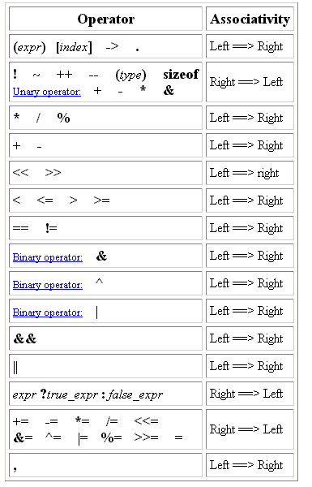
Operator Precedence used in C
Highest
Lowest

Slide 30
Calculator
The followings are for human to read.
a / b - c + d * e - a * c
(((a / b) - c) + (d * e)) - (a * c)
a + b + c = (a + b) + c
a * (b + c)
With the expression for human, it is hard to design a nice algorithm.
Why?
Consider some different expression for machine to work?

Slide 31
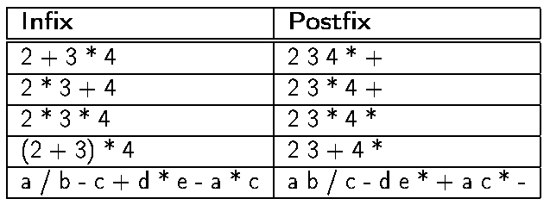
Representations of Expressions
Consider the four binary operators +, -, * and /.
Infix Expressions: a binary operator is placed in-between its two operands. Disadvantages: need to use parentheses and precedence information when evaluate expressions.
Postfix Expressions: Each operator appears after its operands.
Advantages: precedence has been considered when the postfix expression is generated.

Slide 32
The Things to Be Done
Suppose a user gives an infix expression.
Assume it is stored in an array of chars named expr[]
Convert the infix expression to a postfix expression.
Evaluate the postfix expression.
Also assume the postfix expression is stored in an array of chars named expr[]
Return the result to the user.

Slide 33
An Overview
char* expr;
char infix[1000], postfix[1000];
int main() {
int result;
read expression by user into the infix array;
expr = infix; /* expr can be used as an array of char */
postfix(); /* It accesses expr and stores the resulting postfix expression into the postfix array */
expr = postfix;
result = eval();
printf(“%s = %d\n”, infix, result);
return 0;
}

Slide 34
Evaluation of Postfix Expressions Using Stack
Here, we only consider evaluation of expressions using the four binary operators +, -, * and /.
Procedure:
Create a new stack.
Scan the postfix expression from left-to-right.
If an operand is encountered, push it onto the stack.
If a binary operator is encountered,
pop two operands from the stack,
perform the operator, and
push the result onto the stack.
When the postfix expression has been scanned, the result is kept on the top of the stack.
Consider an infix expression: 6 / 2 - 3 + 4 * 2. Its postfix expression is 6 2 / 3 - 4 2 * +. How do we evaluate it? (Refer to the figure on the next page)

Slide 35
To evaluate: 6 2 / 3 - 4 2 * +
stack
stack
stack
2
6 2 / 3 - 4 2 * +
6 2 / 3 - 4 2 * +
3
6 2 / 3 - 4 2 * +
4
6
3
0
6 2 / 3 - 4 2 * +
2
6 2 / 3 - 4 2 * +
6 2 / 3 - 4 2 * +
8
6
0
0
6 2 / 3 - 4 2 * +
6 2 / 3 - 4 2 * +
4
6 2 / 3 - 4 2 * +
3
0
8

Slide 36
Reading Postfix Expressions
typedef enum {plus,minus,times,divide,eos,operand} precedence;
precedence getToken(char *symbol, int *n){
*symbol = expr[(*n)++]; /* expr: the expression string */
switch (*symbol) {
case '+' : return plus;
case '-' : return minus;
case '/' : return divide;
case '*' : return times;
case '\0' : return eos;
default : return operand; /* Assume single digit integers */
}
}
expr=“6 2 / 3 - 4 2 * +”

Slide 37
Evaluating Postfix Expressions
int eval(void){
precedence token; char symbol; stack *s; int op1, op2;
int n = 0; /* counter for the expression string expr*/
s = createS(100);
token = getToken(&symbol, &n);
while (token != eos) {
if (token == operand) {op1 = symbol - '0'; push(s, op1); }
else { op2 = pop(s); op1 = pop(s);
switch(token) {
case plus: push(s, op1 + op2); break;
case minus: push(s, op1 - op2); break;
case times: push(s, op1 * op2); break;
case divide: push(s, op1 / op2); break;
}}
token = getToken(&symbol, &n);
}
return pop(s); /* return result */}
/* char conversion to integer */
stack
6 2 / 3 - 4 2 * +

Slide 38
Supplementary Materials
The ASCII Code:
The char representation of the char ‘0’ is number 48.
The char representation of the char ‘8’ is number 56.
If we need an integer for ‘8’, we need to do ‘8’ – ‘0’ = 56 – 48 = 8.
Call by value vs call by reference
Why do we need ‘call by reference’?
We want to return values in a flexible way.

Slide 39
The American Standard Code for Information Interchange (ASCII)
| 0 NUL| 1 SOH| 2 STX| 3 ETX| 4 EOT| 5 ENQ| 6 ACK| 7 BEL|
| 8 BS | 9 HT | 10 NL | 11 VT | 12 NP | 13 CR | 14 SO | 15 SI |
| 16 DLE| 17 DC1| 18 DC2| 19 DC3| 20 DC4| 21 NAK| 22 SYN| 23 ETB|
| 24 CAN| 25 EM | 26 SUB| 27 ESC| 28 FS | 29 GS | 30 RS | 31 US |
| 32 SP | 33 ! | 34 " | 35 # | 36 $ | 37 % | 38 & | 39 ' |
| 40 ( | 41 ) | 42 * | 43 + | 44 , | 45 - | 46 . | 47 / |
| 48 0 | 49 1 | 50 2 | 51 3 | 52 4 | 53 5 | 54 6 | 55 7 |
| 56 8 | 57 9 | 58 : | 59 ; | 60 < | 61 = | 62 > | 63 ? |
| 64 @ | 65 A | 66 B | 67 C | 68 D | 69 E | 70 F | 71 G |
| 72 H | 73 I | 74 J | 75 K | 76 L | 77 M | 78 N | 79 O |
| 80 P | 81 Q | 82 R | 83 S | 84 T | 85 U | 86 V | 87 W |
| 88 X | 89 Y | 90 Z | 91 [ | 92 \ | 93 ] | 94 ^ | 95 _ |
| 96 ` | 97 a | 98 b | 99 c |100 d |101 e |102 f |103 g |
|104 h |105 i |106 j |107 k |108 l |109 m |110 n |111 o |
|112 p |113 q |114 r |115 s |116 t |117 u |118 v |119 w |
|120 x |121 y |122 z |123 { |124 | |125 } |126 ~ |127 DEL|

Slide 40
Call by value
A procedure can return one thing, which can be any data structure, but just one.
Call-by-value
Suppose there is a procedure int add(int i, int j) {i = i+1, j=j+1; return i+j - 2;}
Consider the following code int i, j, k; i = 10; j = 20; k = add(i, j);
What are the i value (10 or 11) and the j value (20 or 21)?

Slide 41
Call by reference
In many cases, we want to get many things back but we do not want to define a data structure just for returning those things.
Call-by-reference
Suppose there is a procedure int add(int *i, int *j) {*i = *i+1, *j = *j+1; return *i+*j - 2;}
Consider the following code int i, j, k; i = 10; j = 20; k = add(&i, &j);
What are the i value (10 or 11) and the j value (20 or 21)?

